Slide 1
Salesforce Integration
Leverage your investment in Salesforce.

Slide 2
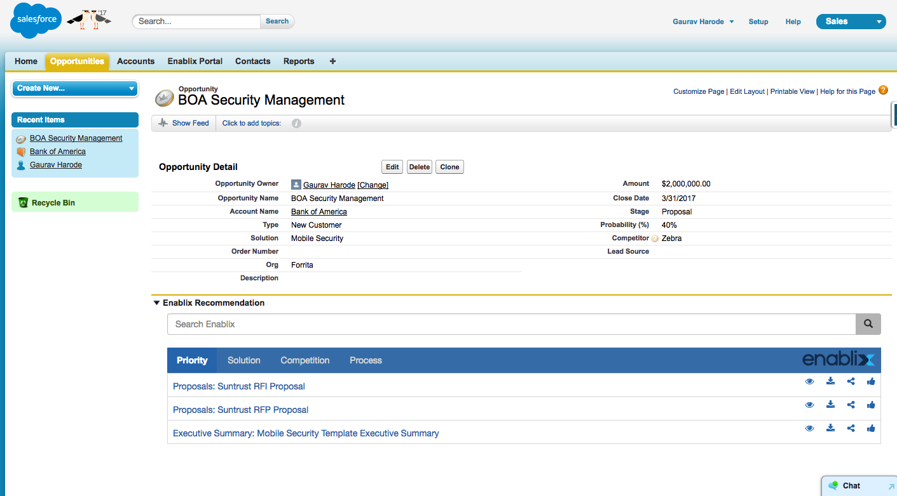
Prioritized & Targeted Content
Prioritized content for sales reps to accelerate opportunity.
Account, Opportunity Stage, Solution & Competitor help identify the context to make recommendations. These factors are configurable.
Reps can search content without leaving Salesforce application.

Slide 3
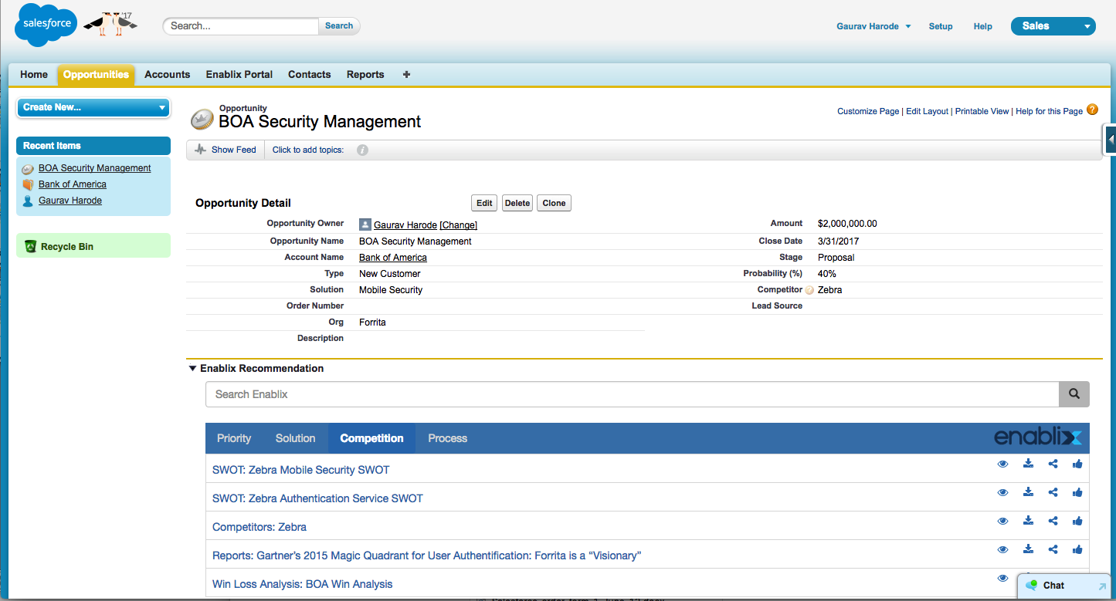
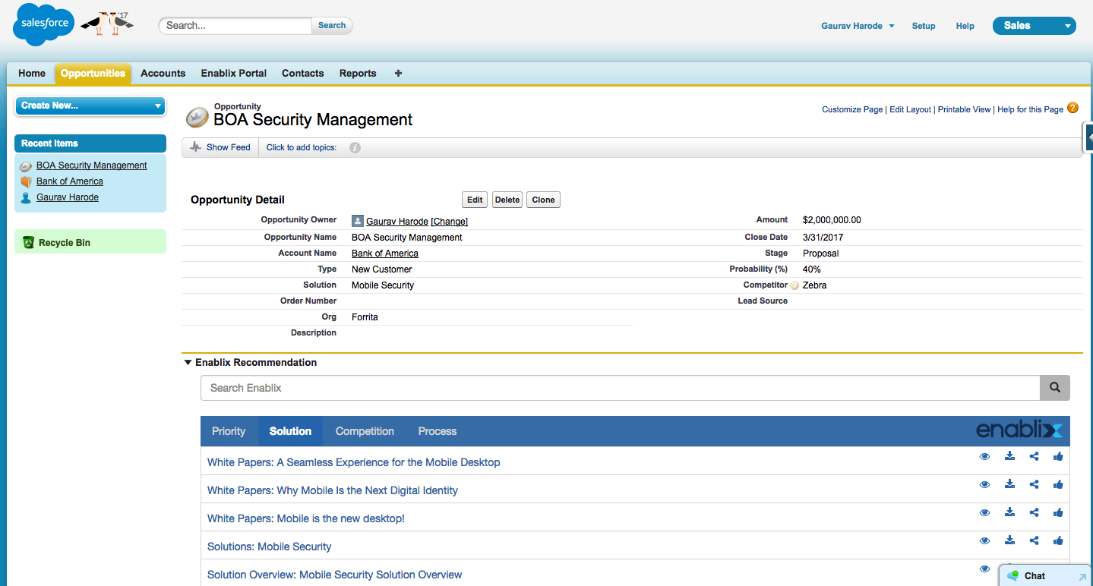
Solution Collateral & Competitive Intelligence
Competitive intelligence one click away.
Filtered and prioritized solution collateral for easy access.

Slide 4
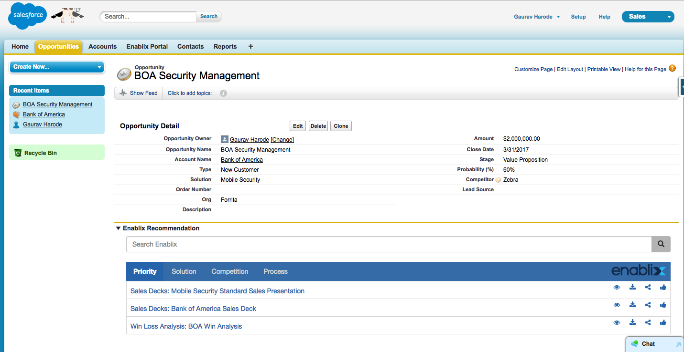
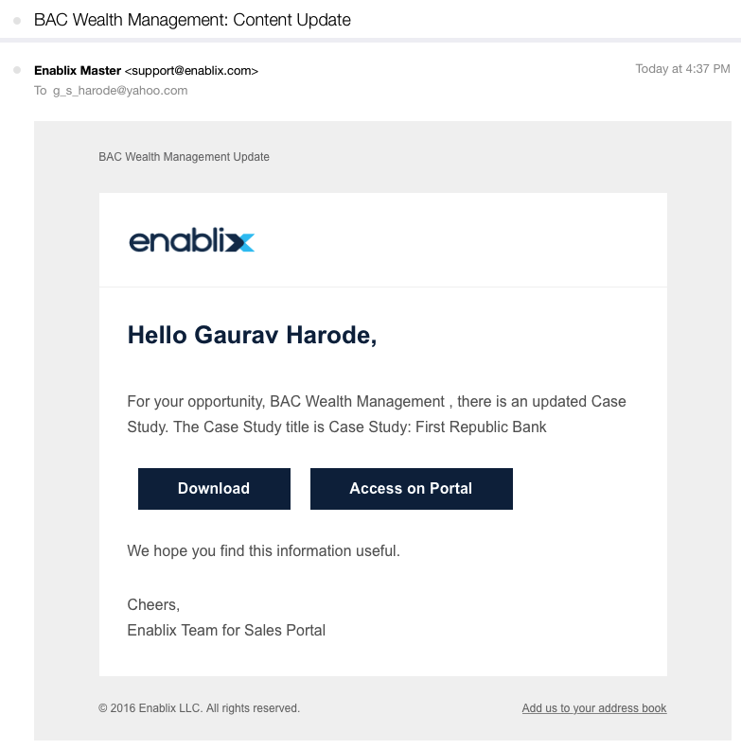
Process Compliance & Email Notifications
Ensure sales process compliance. Sales reps receive targeted corporate documents for every stage of the sales process.
Sales reps receive targeted email notifications informing them about opportunity specific collateral and sales tips.

